Slide 1
Recyclotron
brainfart

Slide 2



What is Recyclotron?
Recyclotron is a smart-bin that detects, identifies and sorts rubbish, reducing user interaction to one bin.
?
?
?
Notes:
These are high level goals

Slide 3
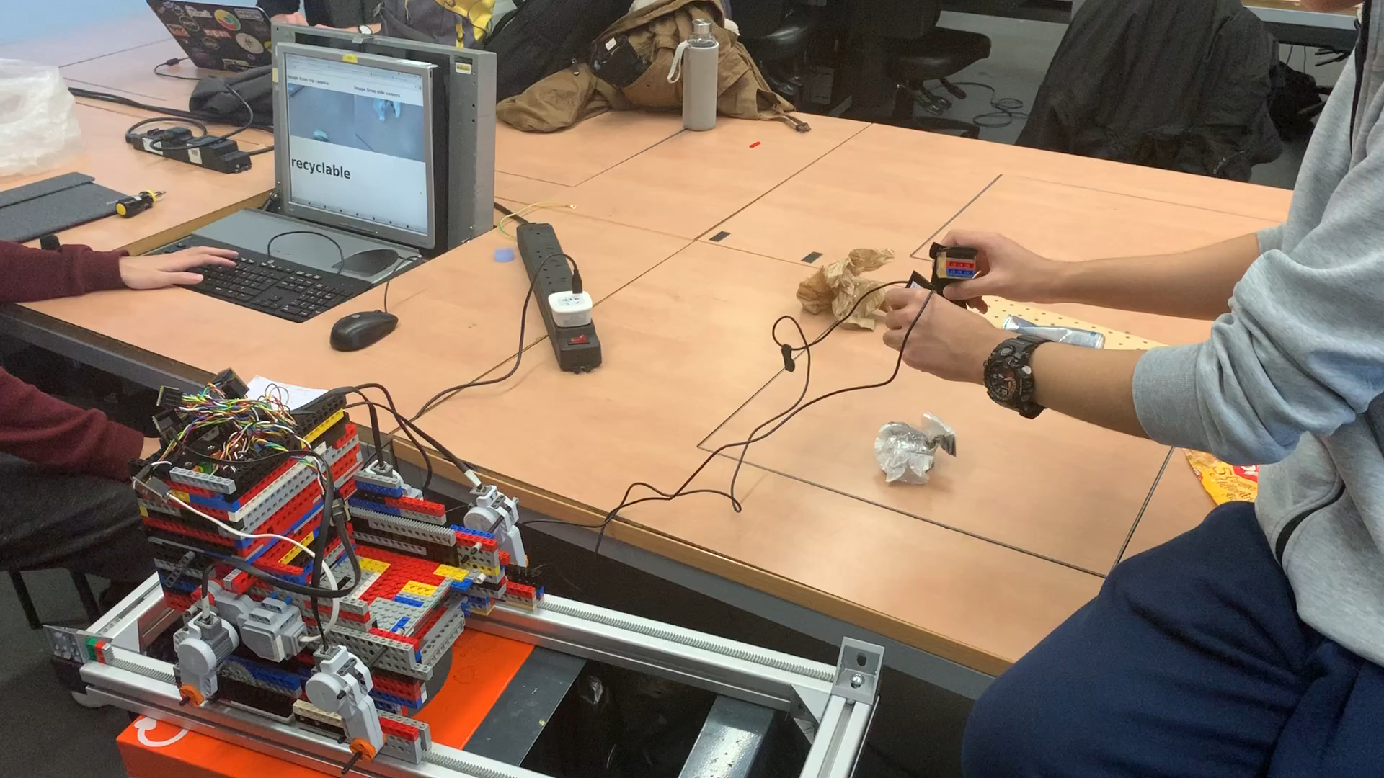
What we made for Demo 1
Cameras
Car
Trash
Trapdoor
Bins
Notes:
These are high level goals

Slide 4
Problems with Demo 1
Cameras had to be held up by a team member
Detection had to be manually started by us, wasn't automatic
Wires and Raspberry Pi were loose (sometimes getting in the way)
Feedback wasn't clear enough to the user
The chamber was unaware of its location and how much it needed to move - movement was hardcoded
Notes:
We did it all! woo

Slide 5
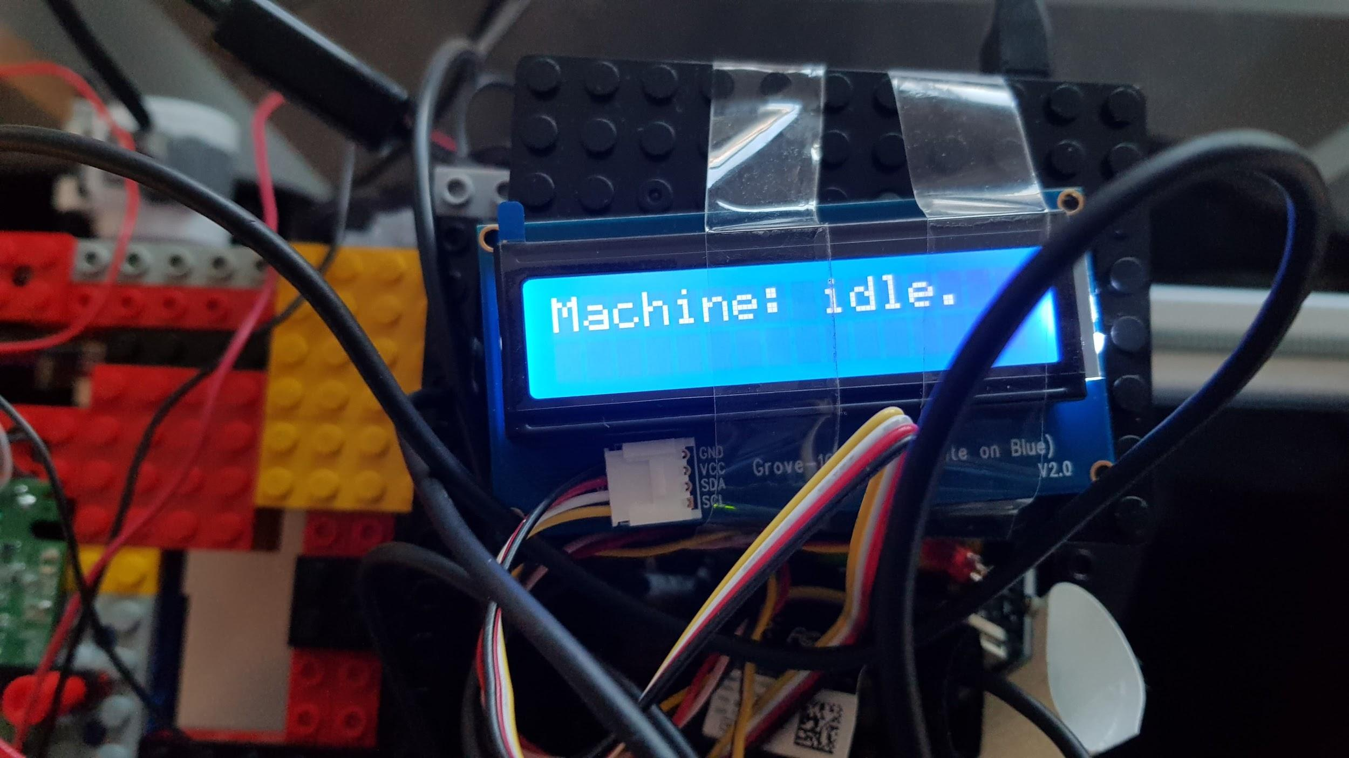
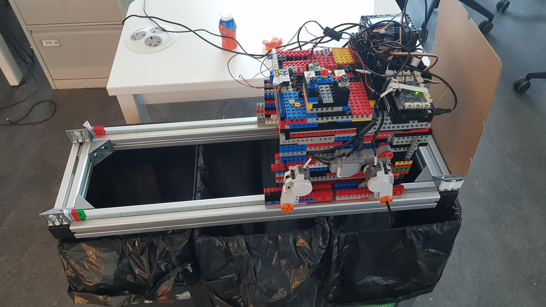
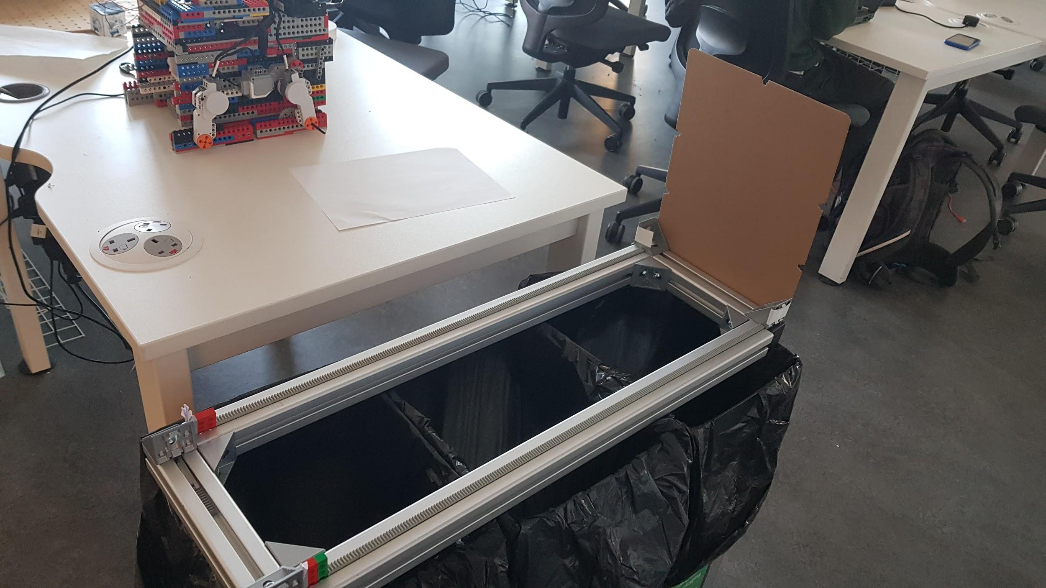
Goals for Demo 2
Add a chamber to hold rubbish, cameras and space for wires
Increase structural stability and scale by 3D printing parts
Add a trigger to detect rubbish
Show clear feedback of what category the rubbish is
Improve the ML Model to have low false positives
Allow the ML model to work with 3 and 4 bins
Recyclable (plastic)
Trash
Metal
Notes:
We did it all! woo

Slide 6
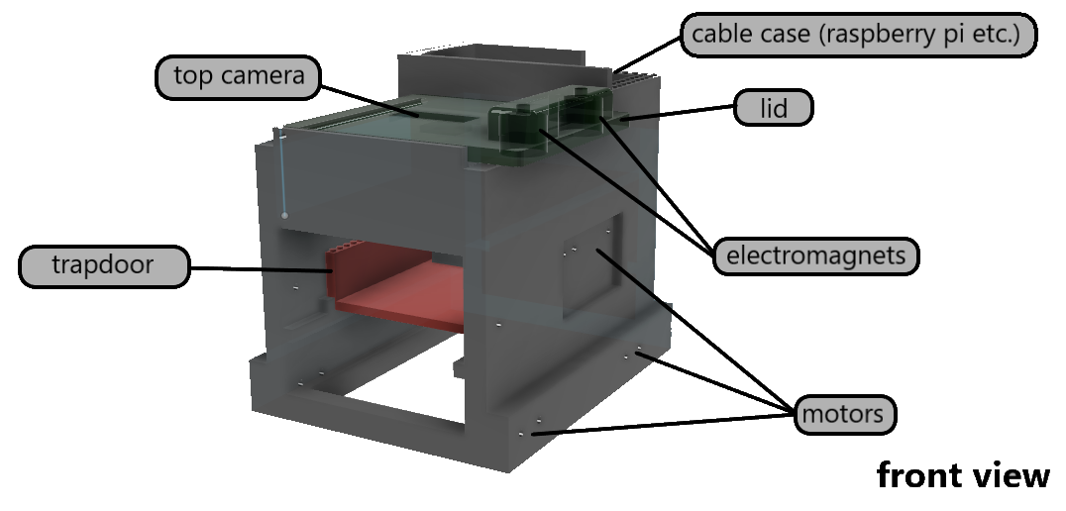

Slide 7
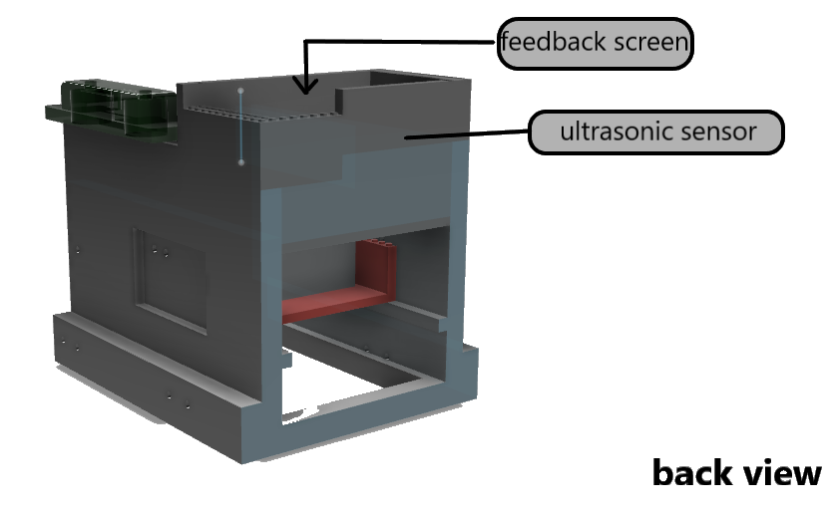

Slide 8
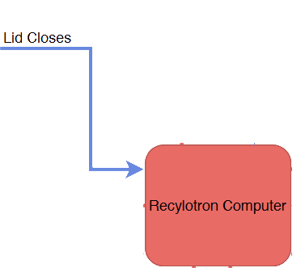
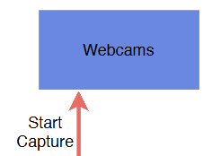
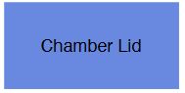
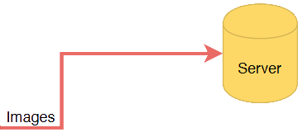
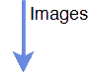
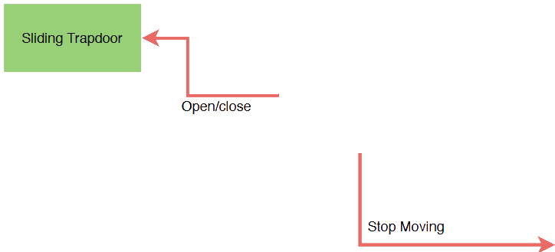
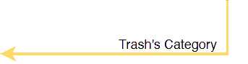
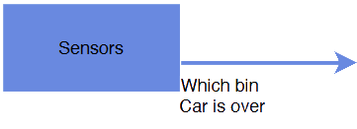
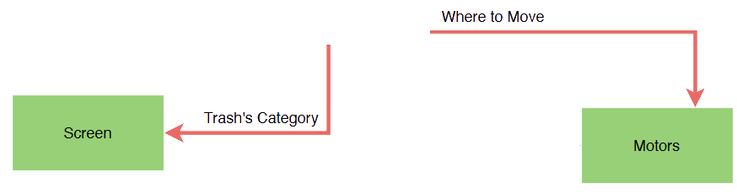

Slide 9
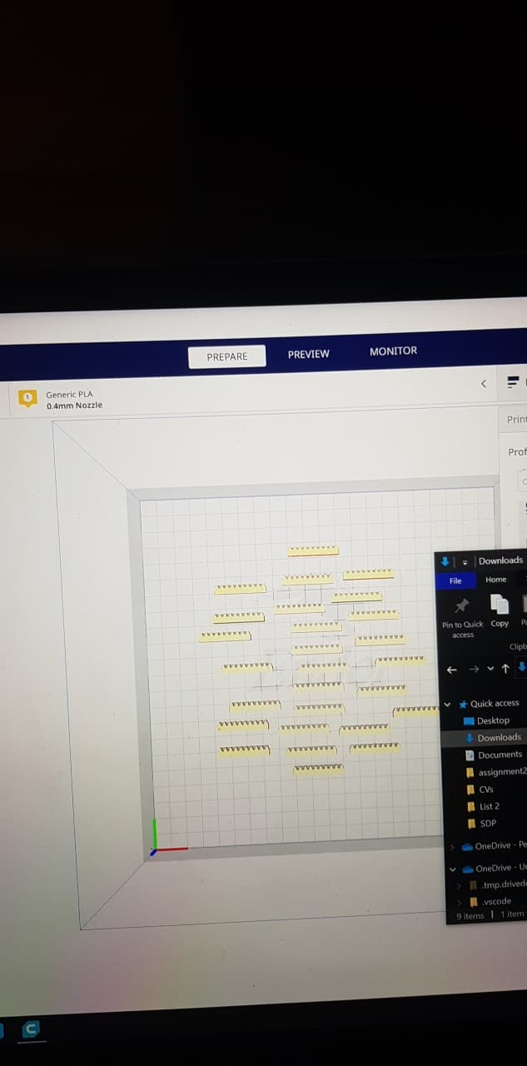
Problems with Hardware
SD Card Crashed
3D Prints Failed Multiple Times
Modeling Turn Around (body took 5 days to print)
Sizing Errors
Lack of Lego Pieces (e.g. gear racks)
Test Name | Number of Trials | Success Rate
Lid Trigger | 50 | 96%
Motor Function | 20 | 100%
Electromagnet (Locking) | 10 | 100%
3D Printing | 7 | 43%
Ultrasonic (Location Detection) | 10 | 90%

Slide 10

Problems with Datasets
Initial size of training dataset was too small (2K images)
Too small for large models like deep neural networks
Very few trash items (only about 100)
Constructed artificially by taking multiple photos of clean items
Testing set was a random split from the training set, so there are some overlap of items between the two sets.
Tests are too easy for classifiers, fails to estimate real world performance.

Slide 11
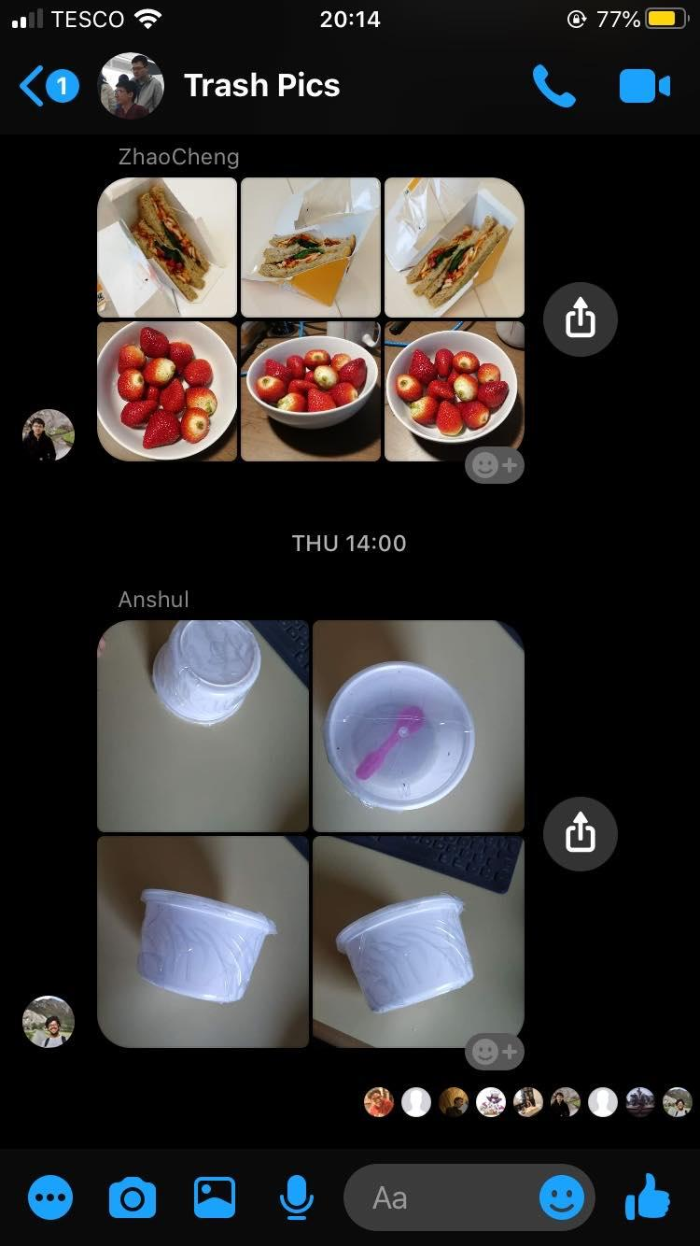
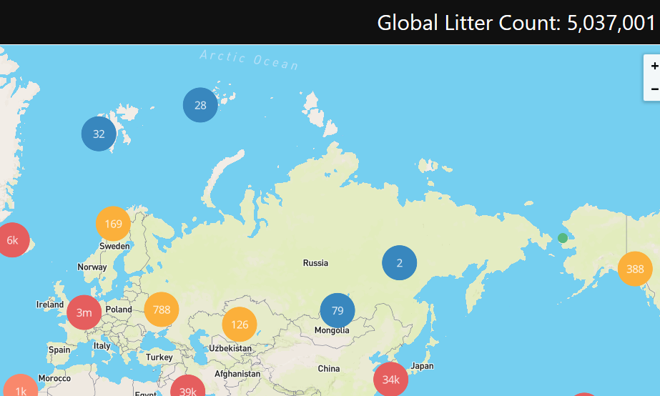
New Datasets
Created our own dataset for testing (only using 111 useful photos for 57 objects)
Found KNN Model performed poorly on new test dataset (~40% accuracy)
So we updated training dataset with images from Litterati’s global map
Now have 1.5 million images to train Recyclotron on!

Slide 12
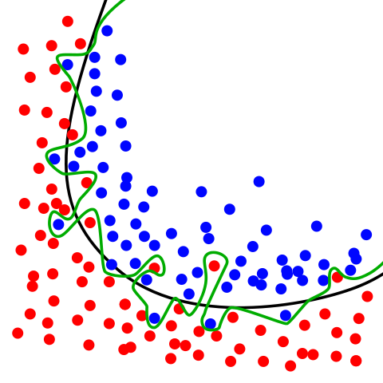
Problems with KNN Model
Poor at generalization - same bottle may be un-recognised at different angles because of KNN’s precision!
KNN is expensive computationally for large training sets - our dataset is too large for KNN to store and process efficiently

Slide 13
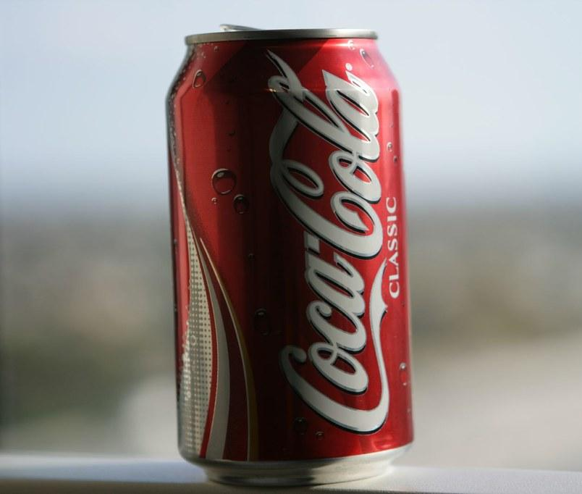
The New Model
Image fed into network
ResNet block 1
ResNet block 2
ResNet block 3
ResNet block 4
ResNet block 5
Each block outputs a feature vector
1
0
1
0
1
1
1
1
1
0
0
1
Feature vectors are concatenated
+
Neural Network Classifier
Classification layer outputs a category
“METAL”

Slide 14
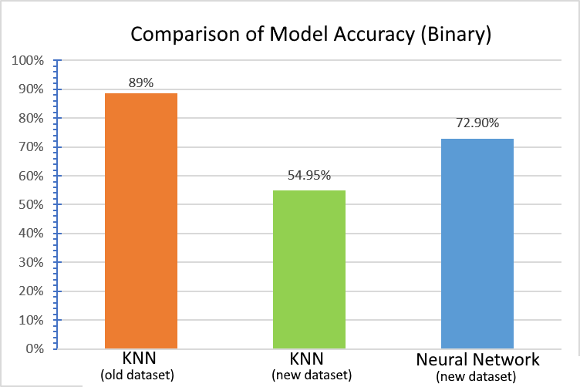

Slide 15
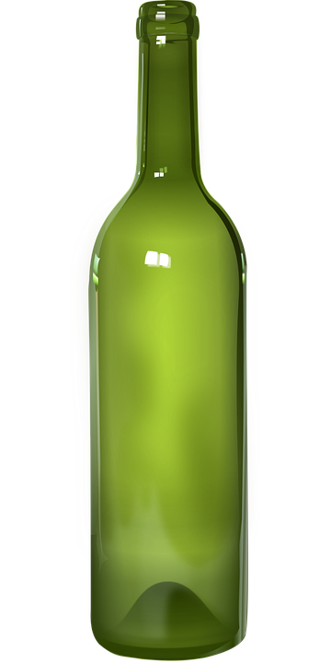
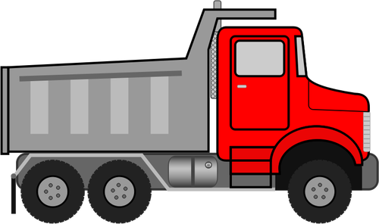
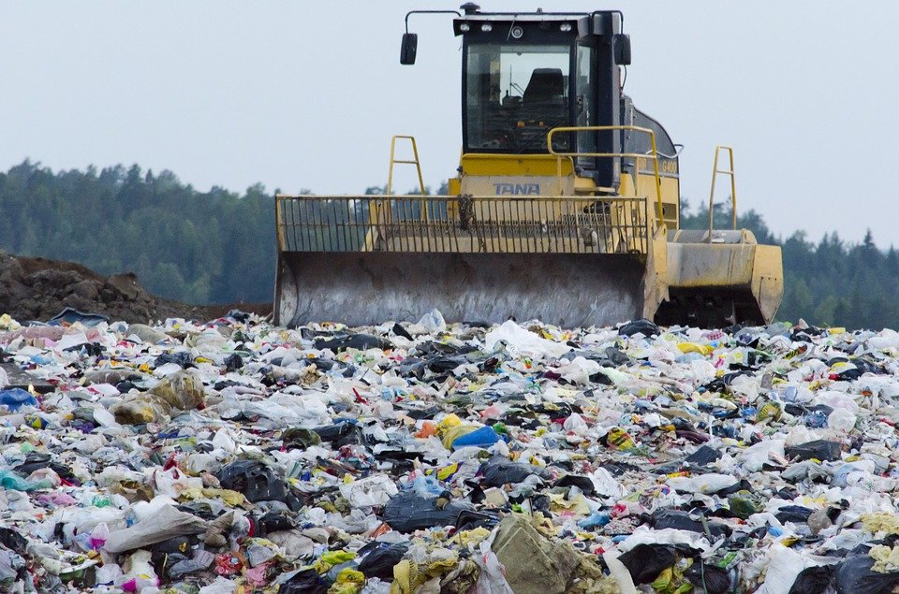
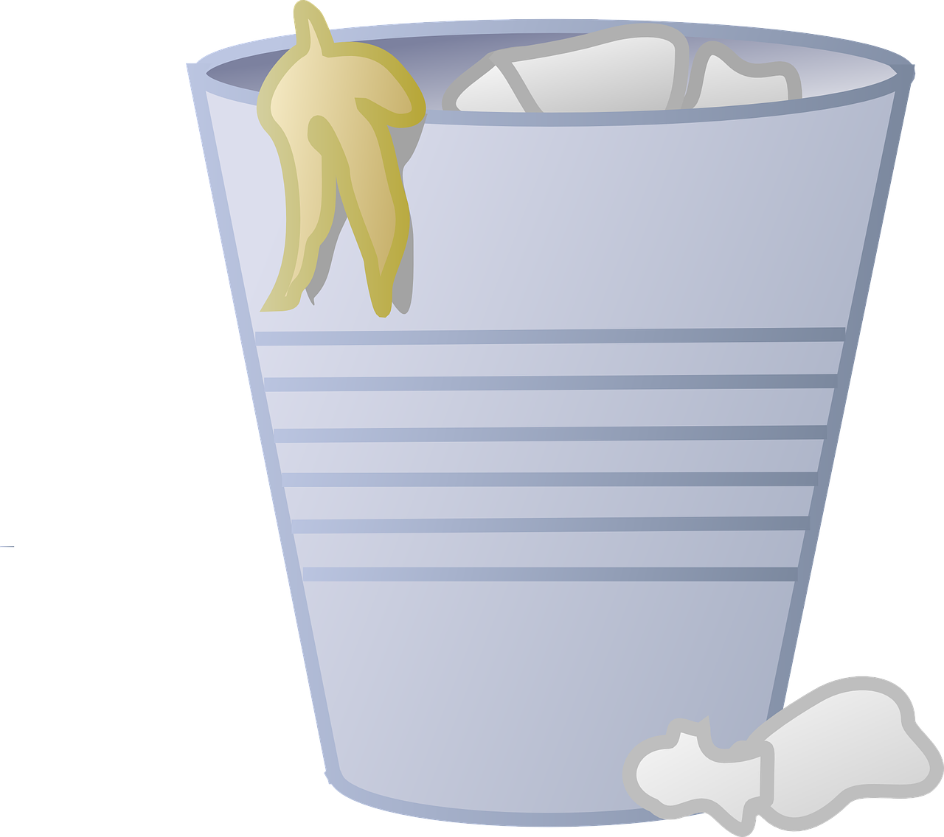
Why are we punishing false positives?
If a recyclable object is categorised as “trash”,
Recyclable object goes into bin
Taken to landfill
Dumped into landfill
Notes:
Recyclable glass bottle gets binned -> lorry takes it to landfill -> dumped in landfill
A regrettable waste of a recyclable object, but goes harmlessly into landfill

Slide 16
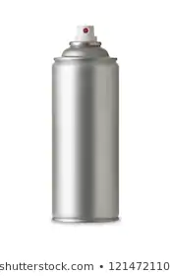


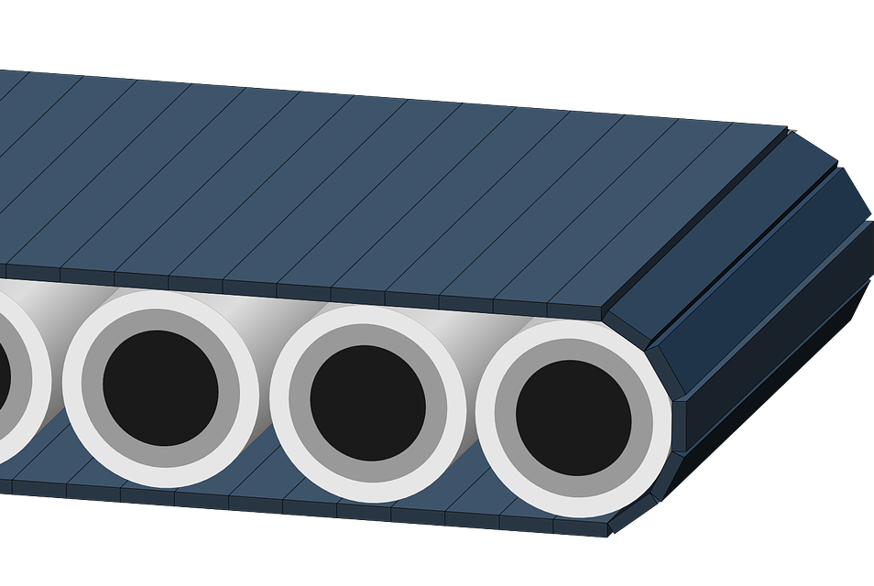
Why are we punishing false positives?
If a “trash” object is categorised as recyclable,
£
Taken to Recycling Facility
Trash is sorted by machines and people
Machines break which costs time and money
Trash goes into recyclable bin
Notes:
The apple gets binned -> lorry takes it to MRF -> Staff have to remove it from line -> money lost
Trash item costs time and money, so not worth the risk
If Trash item can’t be sorted then contaminated rubbish is incinerated

Slide 17
Confusion Matrix (Contingency Table)
 | Glass | Metal | Paper | Plastic | Trash | Precision
Glass | 0 | 0 | 1 | 0 | 0 | 0
Metal | 0 | 2 | 0 | 0 | 1 | 0.67
Paper | 0 | 0 | 20 | 1 | 10 | 0.65
Plastic | 0 | 0 | 0 | 12 | 2 | 0.86
Trash | 0 | 0 | 5 | 11 | 42 | 0.72
Recall | 0 | 1 | 0.8 | 0.48 | 0.76

Slide 18
Confusion Matrix (Contingency Table)
 | Glass | Metal | Paper | Plastic | Trash | Precision
Glass | 0 | 0 | 1 | 0 | 0 | 0
Metal | 0 | 2 | 0 | 0 | 1 | 0.67
Paper | 0 | 0 | 20 | 1 | 10 | 0.65
Plastic | 0 | 0 | 0 | 12 | 2 | 0.86
Trash | 0 | 0 | 5 | 11 | 42 | 0.72
Recall | 0 | 1 | 0.8 | 0.48 | 0.76
False positive rate of 24%!

Slide 19
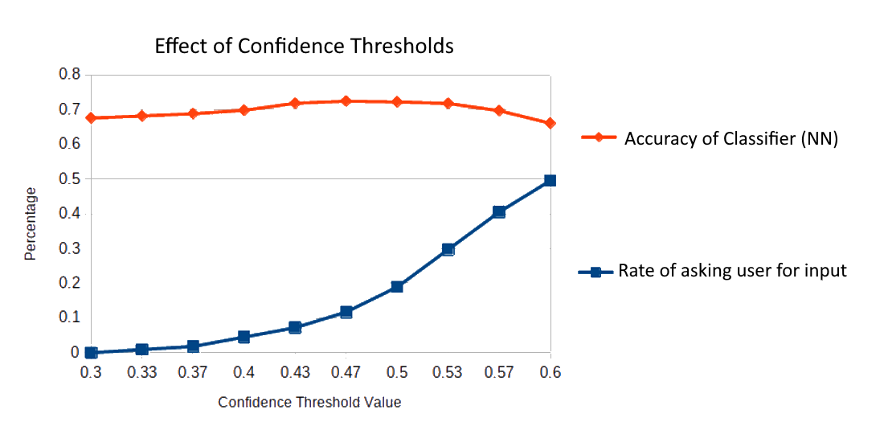

Slide 20
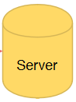
Future Milestone: User Training
=
?
?
?
?
Notes:
These are high level goals

Slide 21
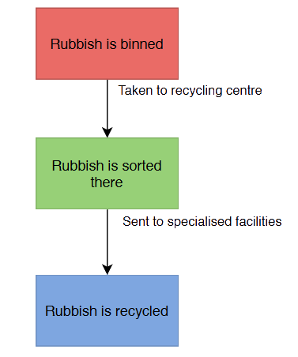
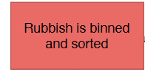
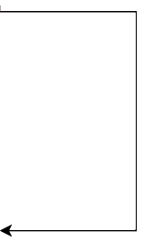
Future Milestone: Highly Extendable

Slide 22
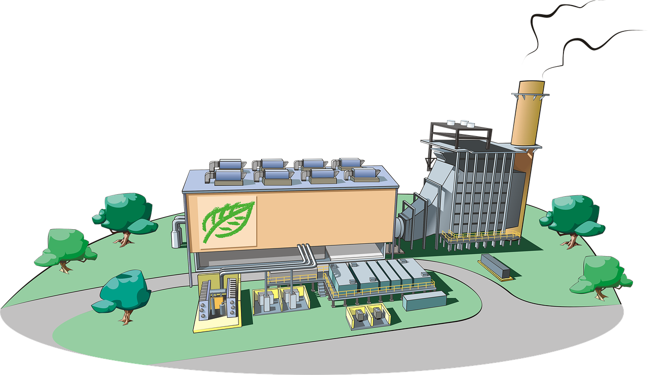
Future Milestone: Highly Extendable
Trash all goes into one bin
Trash taken to Mixed Recycling sorting Facility
Trash is pre-sorted by Recylotron
Trash taken to respective recycling plants

Slide 23
Budget
RED indicates items that were purchased this demo
COMPONENT | COST
3D Printed Body & Lid | £65
3 Electromagnets | £4
2 Ultrasonic Sensors and LCD Screen (GrovePI Kit) | £10
2 LEDs | £3
2 Webcams | £15
5 EV3 Motors | £130
2 Steel Railings | £10
Higher End Raspberry PI | £50
Total Cost | £287
Total Spent | £97

Slide 24
Questions?

